Slide 1
Nonclassical Measurement Error and Farmers’ Response to Information Treatment
Kibrom Abay, Chris Barrett, Talip Kilic, Heather Moylan,
John Ilukor, Wilbert Drazi Vundru
Seminar presentation to CEIDS
December 16, 2022

Slide 2
Background
Non-classical measurement error (NCME) widespread. Usually treated as a problem to be resolved econometrically or through improved survey design.
NCME may represent more than mere misreporting/noise.
If NCME reflects respondents’ mistaken beliefs (Abay et al. AJAE 2021), it offers a window on respondents’ behaviors, esp. concerning information.
Mistaken beliefs could reflect behavioral anomalies: inattention, self-esteem or confirmation bias, etc.
Mistaken beliefs about one subject may spillover to beliefs about, and reporting on, other subjects – with implications for both policy design and statistical inference
Information interventions rely on subjects updating beliefs. Do they?

Slide 3
What we do
Embed a randomized information experiment within a nationwide agricultural household survey in Malawi to study:
The extent, correlates and persistence of NCME
Farmers’ response to new information meant to correct NCME
How farmers learn and adjust to demonstrably accurate information about plot size, both in terms of correcting pre-existing measurement error in plot size as well as their reporting behavior (responses) on non-land agricultural inputs.

Slide 4
Experiment
Built into the Malawi National Crop Cutting Study implemented during the 2019/20 IHS5 (LSMS) national household survey.
National sample of 72 rural EAs, selected at random from the sample of IHS5 EAs that were visited Dec 2020-Feb 2021
In each EA, 24 maize cultivating households randomly selected– 16 into treatment, remaining 8 as control group. (Balance tests indicate that randomization worked properly.)

Slide 5
Experiment (cont’d)
Control Group
Treatment Group
Mirrors the current interview flow in Malawi IHS5/IHPS and LSMS-ISA-supported surveys
Post-harvest visit only w/unified agricultural questionnaire self-reported in 1 sitting by plot managers, prior to plot visit
Randomly select 1 maize plot and accompany that plot’s manager to the plot for demarcation and GPS-based area measurement
Post-planting + post-harvest visit
Post-planting visit same as post-harvest in control except for information treatment:
After self-reports and plot visit, share GPS-based area and self-report measurement error (in levels and as a share of true area)
Post-harvest visit exactly same as controls:
Ask again about the selected plot area

Slide 6
- Regression to mean in NCME: self-reported plot sizes are overestimated for smaller plots, underestimated for larger ones. - NCME is both relatively and absolutely larger for smallest plots.
Familiar findings on NCME (1)

Slide 7
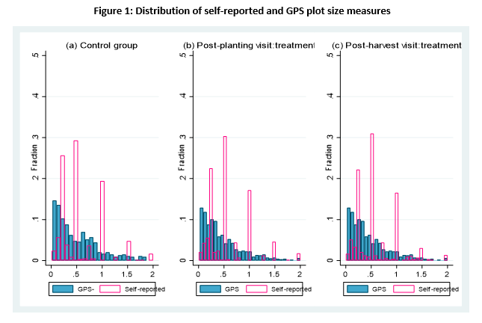
- Rounding is a major source of measurement error in self-reported plot area. - Newer finding: rounding error persists (~unchanged) even after information treatment
Familiar findings on NCME (2) … and newer ones

Slide 8
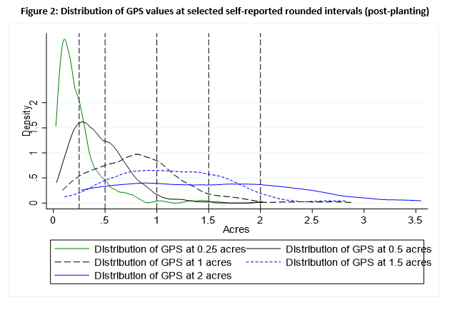
- Heaping around focal plots is asymmetric, esp. for smallest plots
Newer findings on NCME (2)

Slide 9
- ME is heavily NC, and overwhelmingly associated w/true plot size and rounding
Familiar findings on NCME (3) … and newer ones (3)

Slide 10
NCME is the norm. Only 3.1% (31/982) accurately self-report plot size pre-treatment. Systematic NCME strikingly consistent w/behavioral phenomena: - Inattention to salient information: may be rational (costs>benefits) or irrational (mental gaps, oversight). Variation with true plot size suggests structurally asymmetric inattention. - Self-esteem bias: land a source of status. Upwardly biased mistaken beliefs may bring non-material reward. Asymmetric NCME and focal point bunching consistent w/this.
Newer findings on NCME (4)

Slide 11
NCME at least partly reflects farmer misperceptions (not just misreporting). Building on Abay et al. (AJAE 2021), look for plot size ME reflected in non-land inputs (seed, fertilizer, labor) self-reported post-treatment post-planting:
Familiar findings on NCME (4)
If reject null θ₂=0 in favor of θ₂ >0, then NCME reflects farmer misperceptions (not just misreporting) and/or correlated NCME (Abay et al. JDE 2019).
Overwhelmingly reject null in any specification. Finding reinforced by asymmetry: self-reported non-land inputs more strongly associated with underreporting of plot size than overreporting.

Slide 12
Familiar findings on NCME (4)

Slide 13
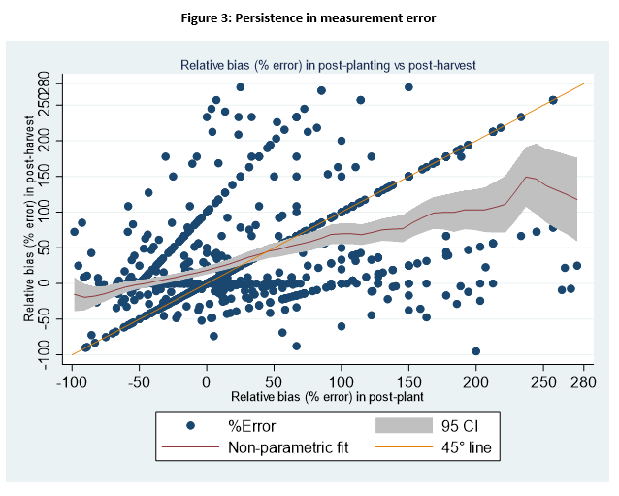
Learning is sluggish among treated… - 13% accurately self-report post-treatment. - Plurality (37%) don’t change incorrect beliefs. - 23% report larger ME post-treatment! - 13% switch from one rounded, wrong value for another wrong, rounded one.
Newer findings on NCME and learning

Slide 14
Incomplete and structurally asymmetric learning: Under-estimators with larger plots more likely to update and by a larger amount.
Newer findings on NCME and learning

Slide 15
Newer findings on NCME and learning
Incomplete and structurally asymmetric learning: Only 13% (up from 3%) correct. Overestimation magnitude unchanged but underestimation falls.

Slide 16
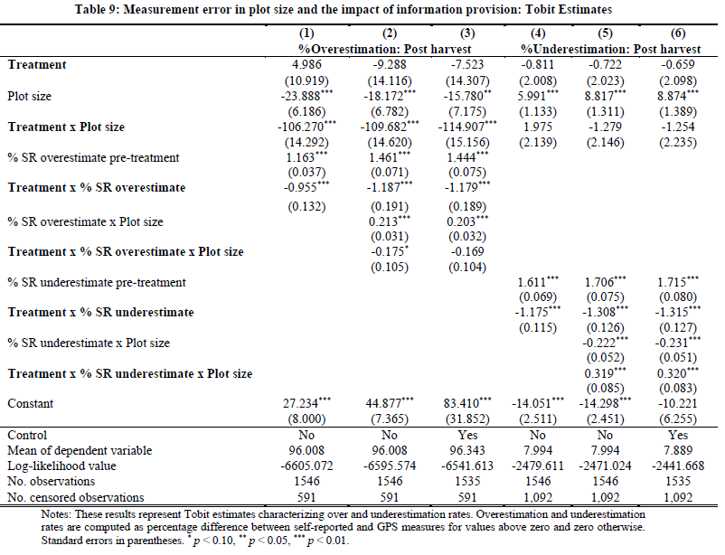
Newer findings on NCME and learning
Incomplete and structurally asymmetric learning:

Slide 17
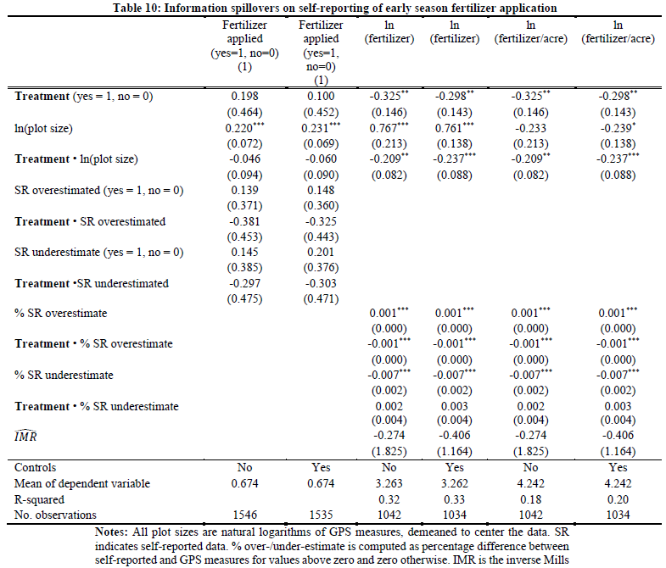
Information treatment has - no effect on fertilizer use reporting at extensive margin - significantly changes intensive margin self-reports (~7%). - treatment effects heterogeneous by plot size and by under/over-estimation. - clear evidence of spillovers on self-reporting of (early season) agricultural input use ... correlated NCME (Abay et al. JDE 2019). Optimal prediction error (Hyslop and Imbens JBES 2001)?
Newer findings on NCME and learning

Slide 18
Conclusions and implications
Considerable NCME in SR plot areas reflects asymmetric rounding and regression-to-mean consistent with behavioral anomalies such as inattention, self-esteem bias.
NCME persists among the treated 3 to 4 months following treatment. Very incomplete and asymmetric updating. Upward corrections more common. Extent of updating varies with true plot area and direction/magnitude of pre-treatment ME.
Widespread mistaken beliefs and asymmetric updating suggests behavioral anomalies that matter for:
Design and implementation of information-based interventions
Survey data collection and statistical inference (esp. correlated NCME)

Slide 19
Thank you for your interest and comments cbb2@cornell.edu

